Slide 1
Variable | Description | Categories
Gender | Sex of students | Male Female
Nationality | The citizenship of students | Domestic(USA) International
Ethnicity | The state of students’ belongings to a social group | White Asian American Hispanic or Latino African American Unknown 2 or more races
Major | Students’ main area of study when taking the course. | Mechanical Engineering(ME) Agriculture Engineering(AAE) Nuclear Engineering(NE) Others
Table 1. Description and Categories of Independent

Slide 2
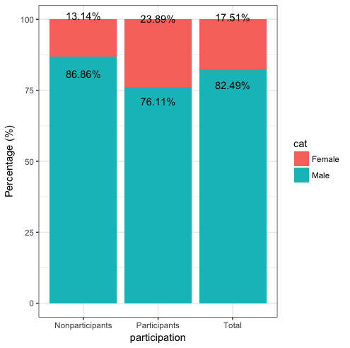

Slide 3
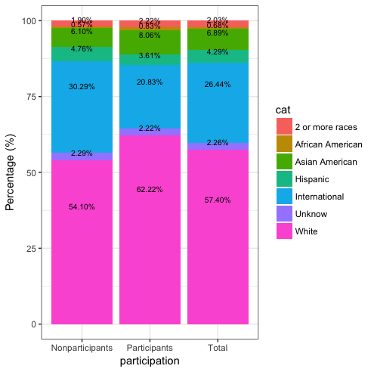

Slide 4
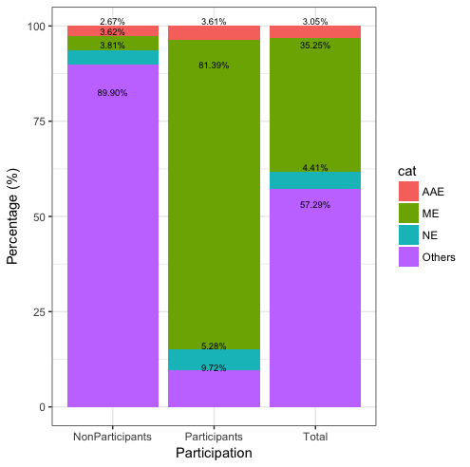

Slide 5
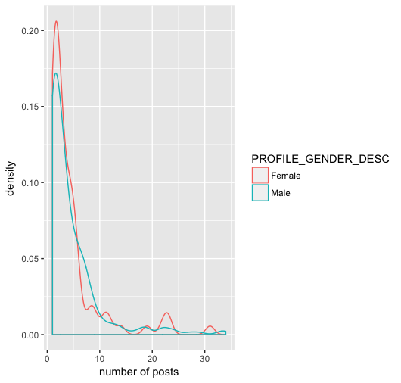

Slide 6
Variable | P.Level | Female | Male | X² | P | Cramer’s V
 | Participants | 86 | 274 | 16.33 | 3.62e-05 | 0.1389
Gender | Nonparticipants | 69 | 456
 | Total | 155 | 730
 |  | White | Asian American | International | Hispanic
 | Participants | 224 | 29 | 75 | 13 | 11.529 | 0.0092 | 0.1939
Ethnicity | Nonparticipants | 284 | 32 | 159 | 25
 | Total | 508 | 61 | 234 | 38
 |  | ME | NE | AAE | Others
Major | Participants | 293 | 19 | 13 | 35 | 607.72 | <2.2e-16 | 0.8287
 | Nonparticipants | 19 | 20 | 14 | 472
 | Total | 312 | 39 | 27 | 507
Table 2: Individual Characteristics Showing Significant Association with Participation status

